Slide 1

FITRE: Fisher Informed Trust-region Method for Training Policy Networks
Jan. 2021

Slide 2
What is FITRE?
FITRE is a high order optimizer which can be used in training deep neural networks
Advantages of FITRE
Fewer tuning parameters
Fewer steps to reach higher reward
Scalable to large problem
How does FITRE achieve these?
Use natural gradient to decide update direction
Use trust-region method to decide update step size
Modifications made to apply FITRE on reinforcement learning
Original FITRE algorithm is designed for supervised learning
We modified the algorithm to support reinforcement learning
FITRE now supports both continuous and discrete models

Slide 3
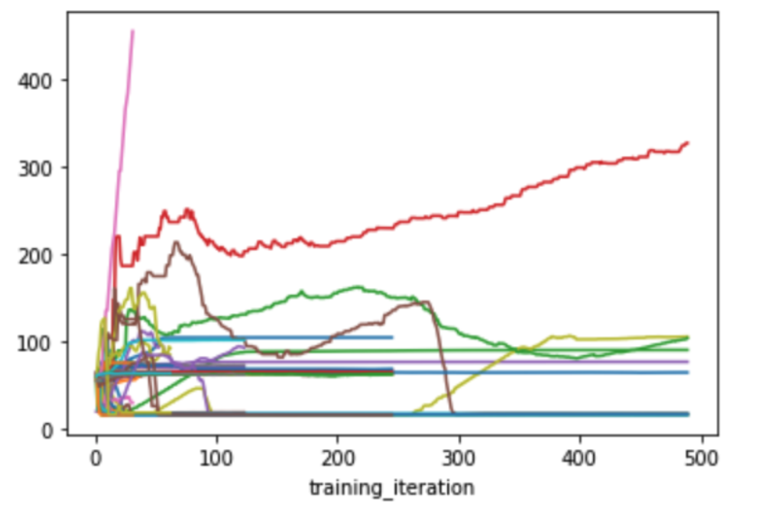
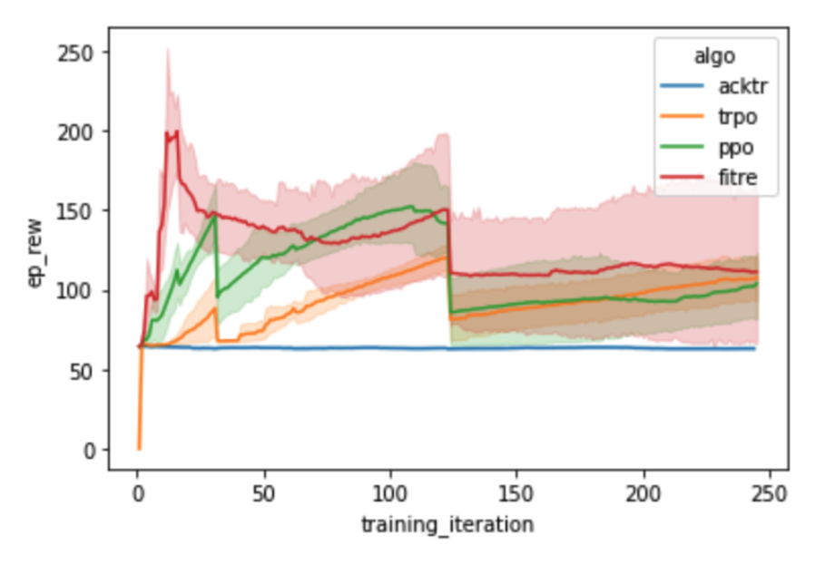
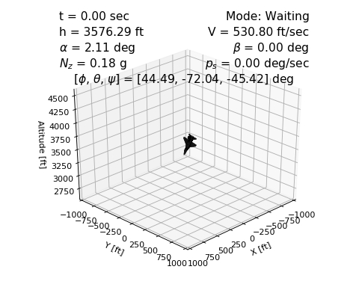
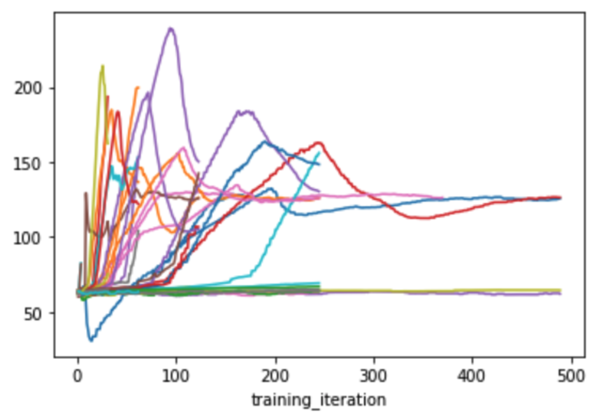
Comparison and demo on F16
FITRE plot
Top 5 plot of different methods
Simulation
The following is a 15 seconds simulation of the F16 model. The plane is controlled by a neural network trained by FITRE.
Compare to PPO
Conclusion:
FITRE achieved highest reward using fewest iterations
Notes:
We run 50 trials for different optimization methods. Trajectories in the left two plots show rewards of one trial at different iterations. Trajectory in the right plot represents the mean of top five rewards of each algorithm, while the shade represents derivation.

Slide 4
Thank you
Q & A

